Slide 1


Slide 2

Status
Current Version: 1.0
Version 1.1 in development
New versions will always be backwards compatible

Slide 3
What is JSON:API?
JSON: JavaScript Object Notation is a language-independent text format that is mainly used to transmit data between a server and a browser.
API: is a very useful mechanism that allows two pieces of software to exchange messages or data in strand format.
.
Notes:
Include something about backwards compatibility here

Slide 4
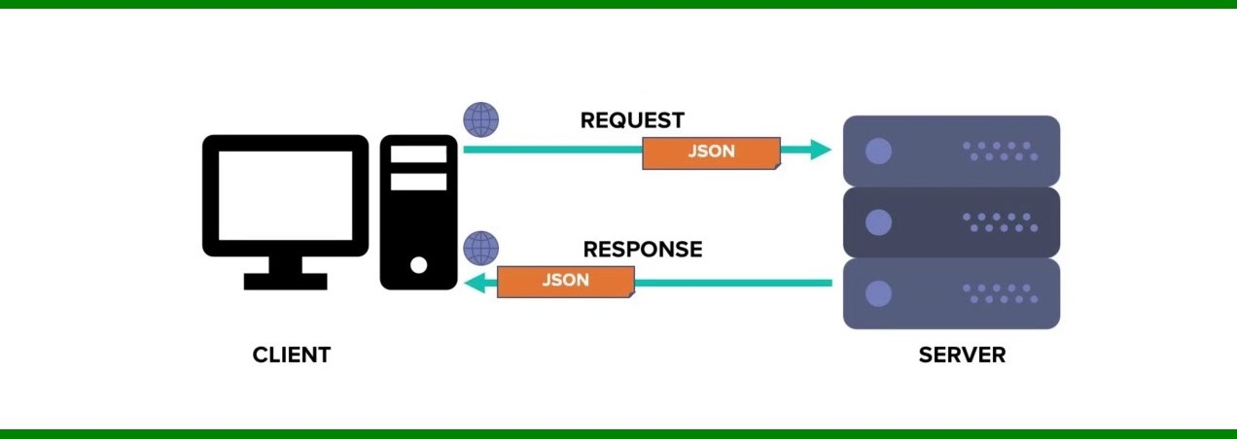
What is JSON:API?
JSON:API
is a format that works with HTTP. It delineates how clients should request or edit data from a server, and how the server should respond to said requests
.
Notes:
Include something about backwards compatibility here

Slide 5
Why is JSON:API ?
Compound Documents
Compound documents is a unique ability in JSON API, allowing servers to send related resources alongside the requested primary resources — if implemented correctly this could decrease the number of necessary HTTP requests.
Sparse Fieldsets
If you’re using compound documents to include related resources, you could run into an issue of having large responses. Once again, JSON API has a solution.
Another unique aspect of JSON API are sparse fieldsets, which enable clients to only request data from specific fields. It works by adding the field you want to retrieve to the URI parameter with the resource name and the fields you want.

Slide 6
Why is JSON:API ?
Optionality
Many of the features in JSONAPI.org are purely optional; you can turn them off or on.
Optimization Features
JSON API comes equipped with many features to optimize the API return package. Special server side operations in JSON API include sorting, as well as pagination; the ability to limit the number of returned resources to a subset, with first, last, next, and prev links.
Caching
In JSON API use cases, caching is in essence built into HTTP. Since clients using JSON API access data in the same way, they don’t need to store data in various locations. This design may require a shift in thought, yet if used correctly can bring significant optimization benefits.

Slide 7
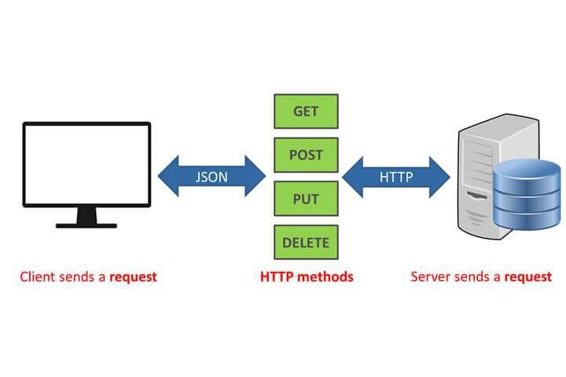
Notes:
Client sends request using HTTP method

Slide 8
Client Responsibilities
Clients request data from the server.
Clients MUST send all JSON:API data in request documents with the header Content-Type: application/vnd.api+json without any media type parameters.
Clients that include the JSON:API media type in their Accept header MUST specify the media type there at least once without any media type parameters.
Clients MUST ignore any parameters for the application/vnd.api+json media type received in the Content-Type header of response documents.
Notes:
Kaleb’s slide

Slide 9
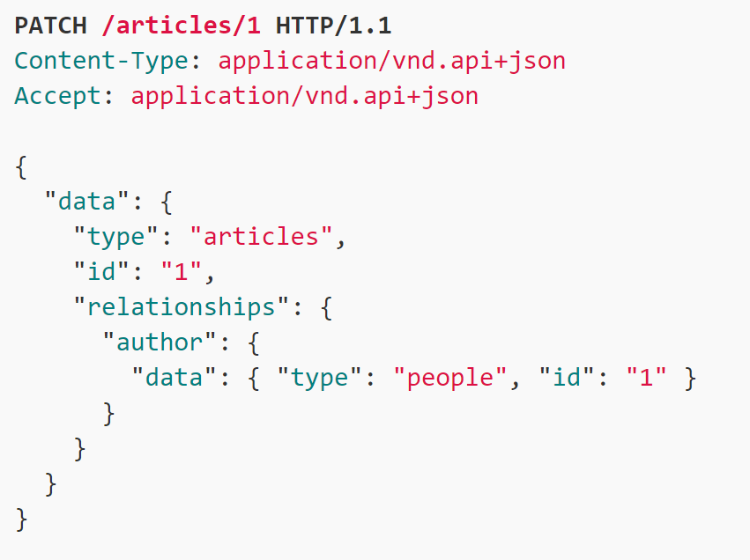
Example
Will be discussed in further detail with other groups’ presentations
Notes:
Kaleb’s slide

Slide 10
Server Responsibilities
Servers respond to clients requests
Servers MUST send all JSON:API data in response documents with the header Content-Type: application/vnd.api+json without any media type parameters.

Slide 11

Server Responsibilities
If proper JSON:API media type is not present in client request header Server will respond with…
Status code: 415 Unsupported Media Type
If the request Accept: header is not application/vnd.api+json, Server will respond with..
Status code: 406 Not Acceptable

